Slide 1


Weekly summary reports
Scott Reese
CONFIDENTIAL & BUSINESS PROPRIETARY INFORMATION OF UNDER ARMOUR, INC.

Slide 2


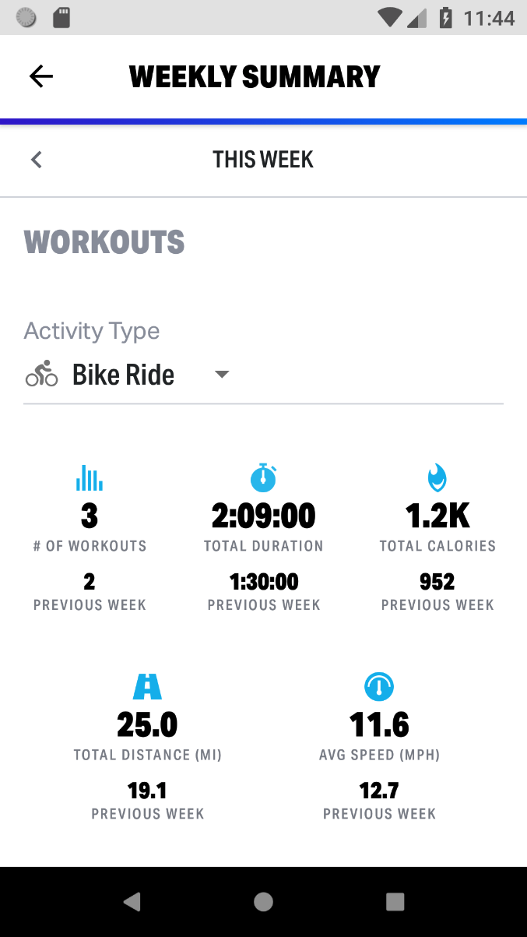
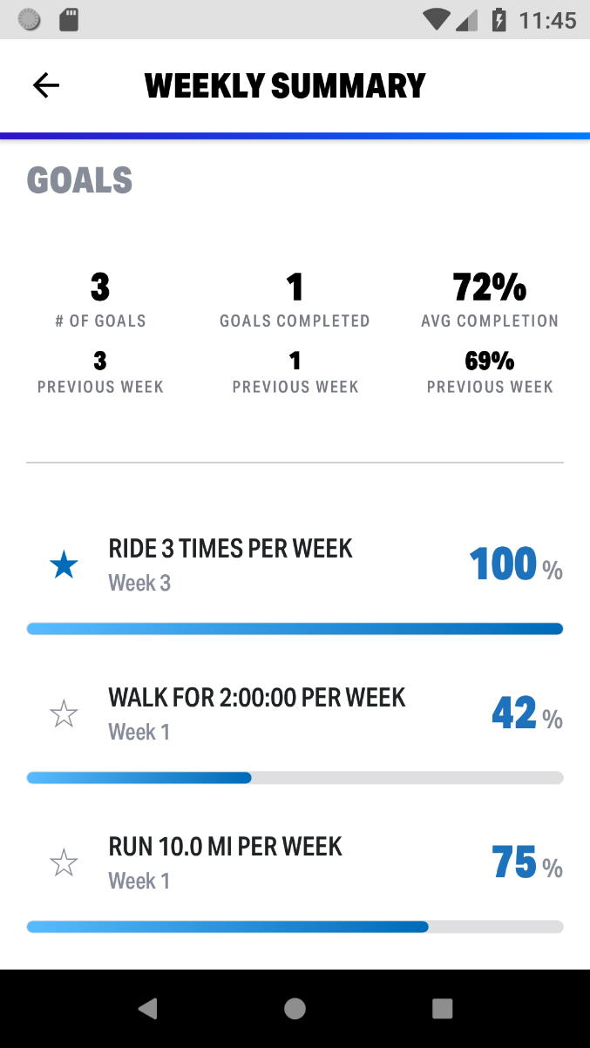
Quick glance
Aggregate statistics for workouts
# of Workouts
Total Duration
Total Calories
Total Distance
Average Speed/Pace
Aggregate statistics for goals
# of Goals
Goals Completed
Average Completion Rate
Progress Bars
Previous week statistics
Easy to track weekly progress
CONFIDENTIAL & BUSINESS PROPRIETARY INFORMATION OF UNDER ARMOUR, INC.

Slide 3
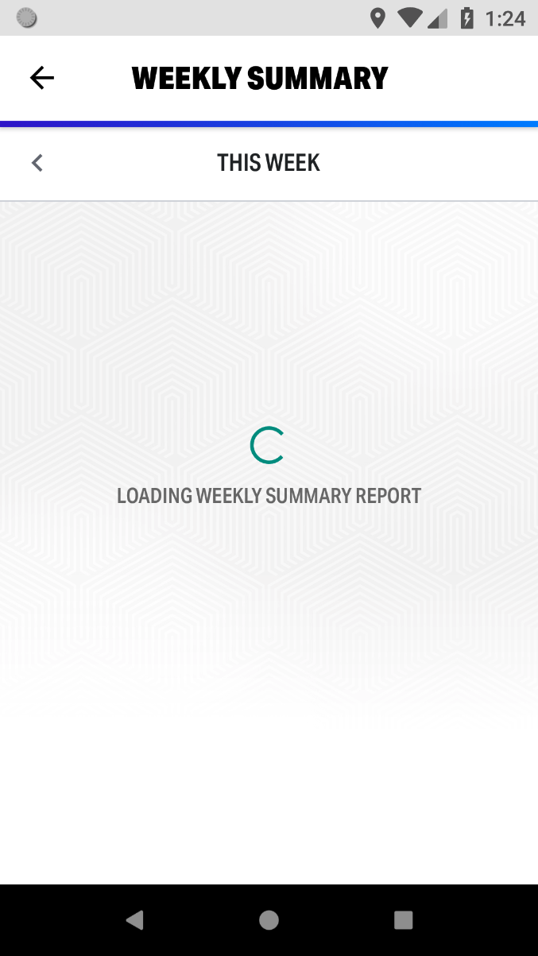
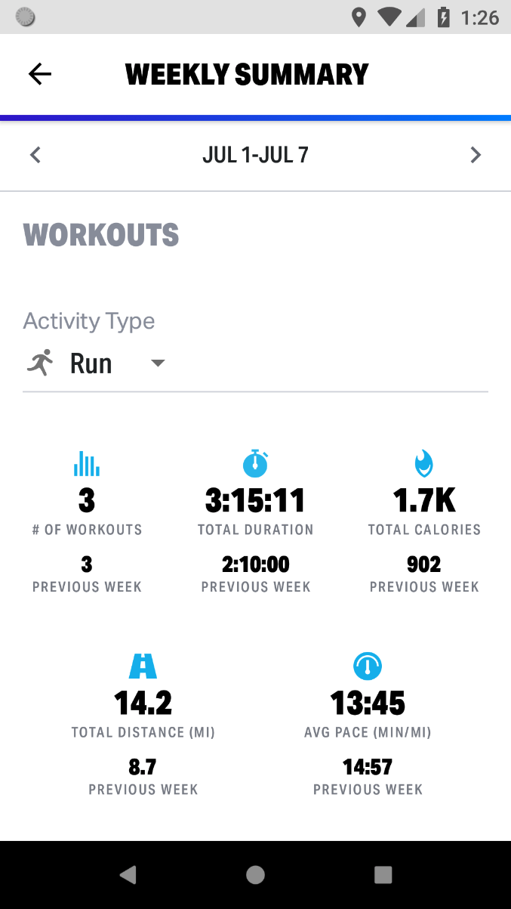
Summary report history
CONFIDENTIAL & BUSINESS PROPRIETARY INFORMATION OF UNDER ARMOUR, INC.

Slide 4
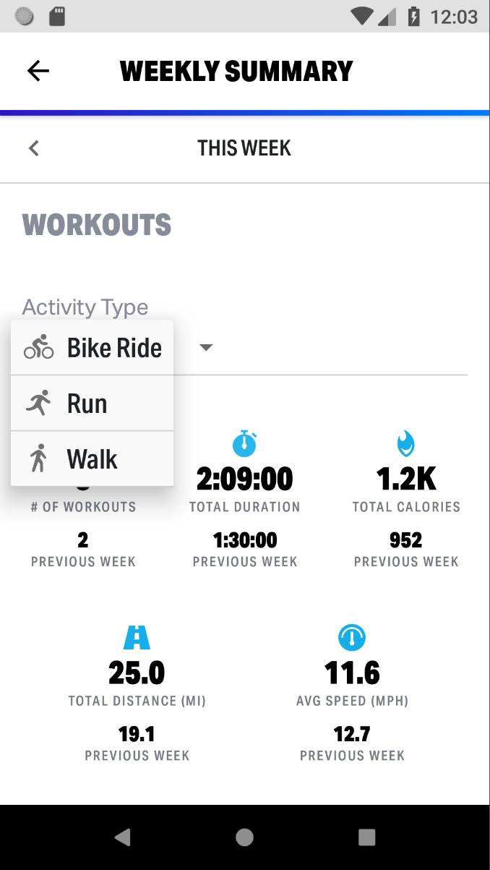
Workout type selection
SLIDE TITLE
CONFIDENTIAL & BUSINESS PROPRIETARY INFORMATION OF UNDER ARMOUR, INC.

Slide 5
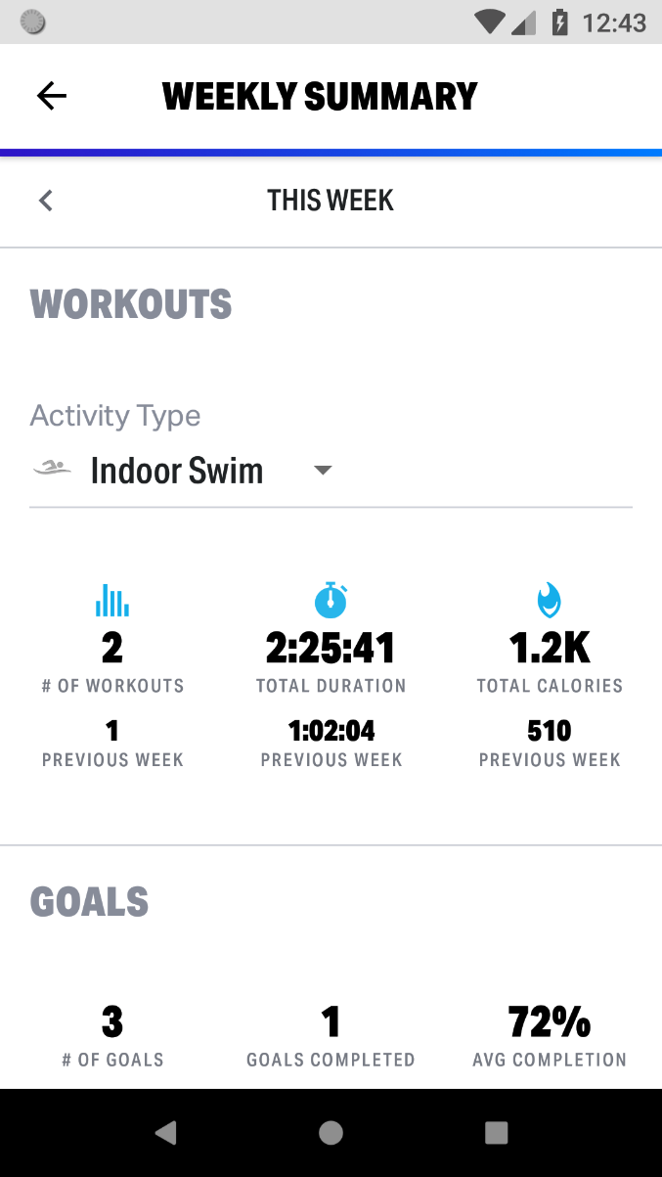
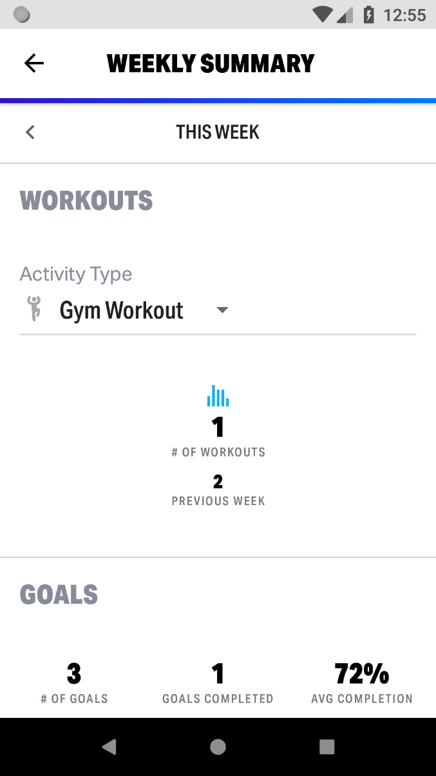
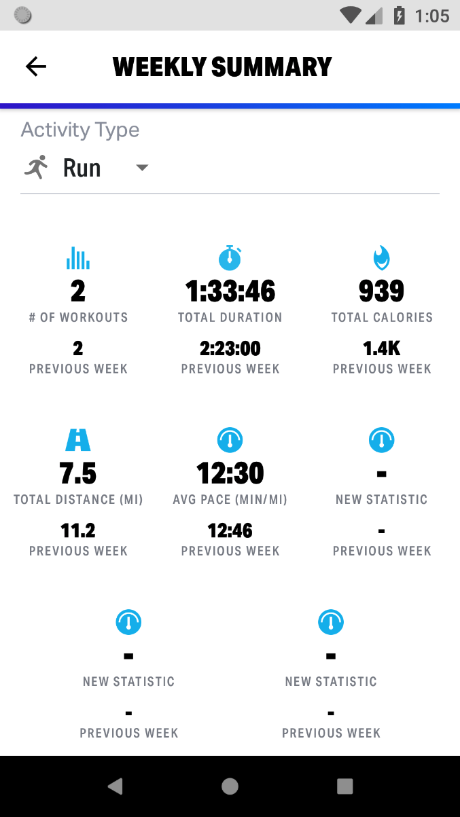
Dynamic presentation
5 statistics
3 statistics
1 statistic
8 statistics
CONFIDENTIAL & BUSINESS PROPRIETARY INFORMATION OF UNDER ARMOUR, INC.

Slide 6
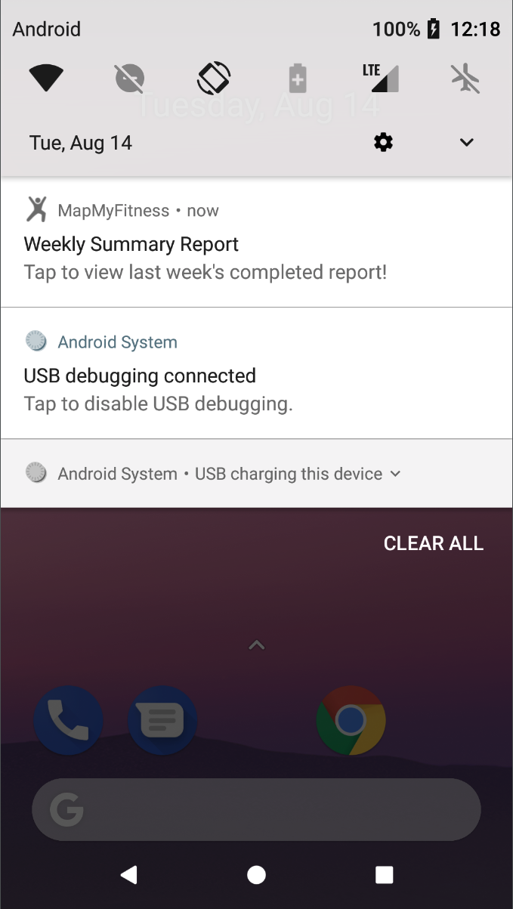
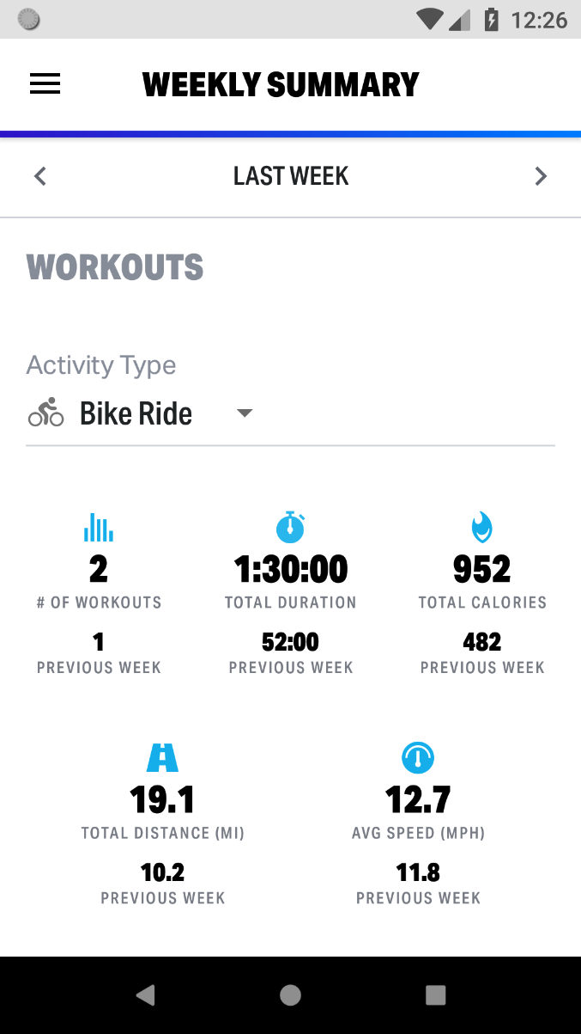
Weekly notification
Remind users to check their report for the previous completed week
Notification every Sunday morning
A good way to provide motivation
Alerts users of the feature’s existence
CONFIDENTIAL & BUSINESS PROPRIETARY INFORMATION OF UNDER ARMOUR, INC.

Slide 7
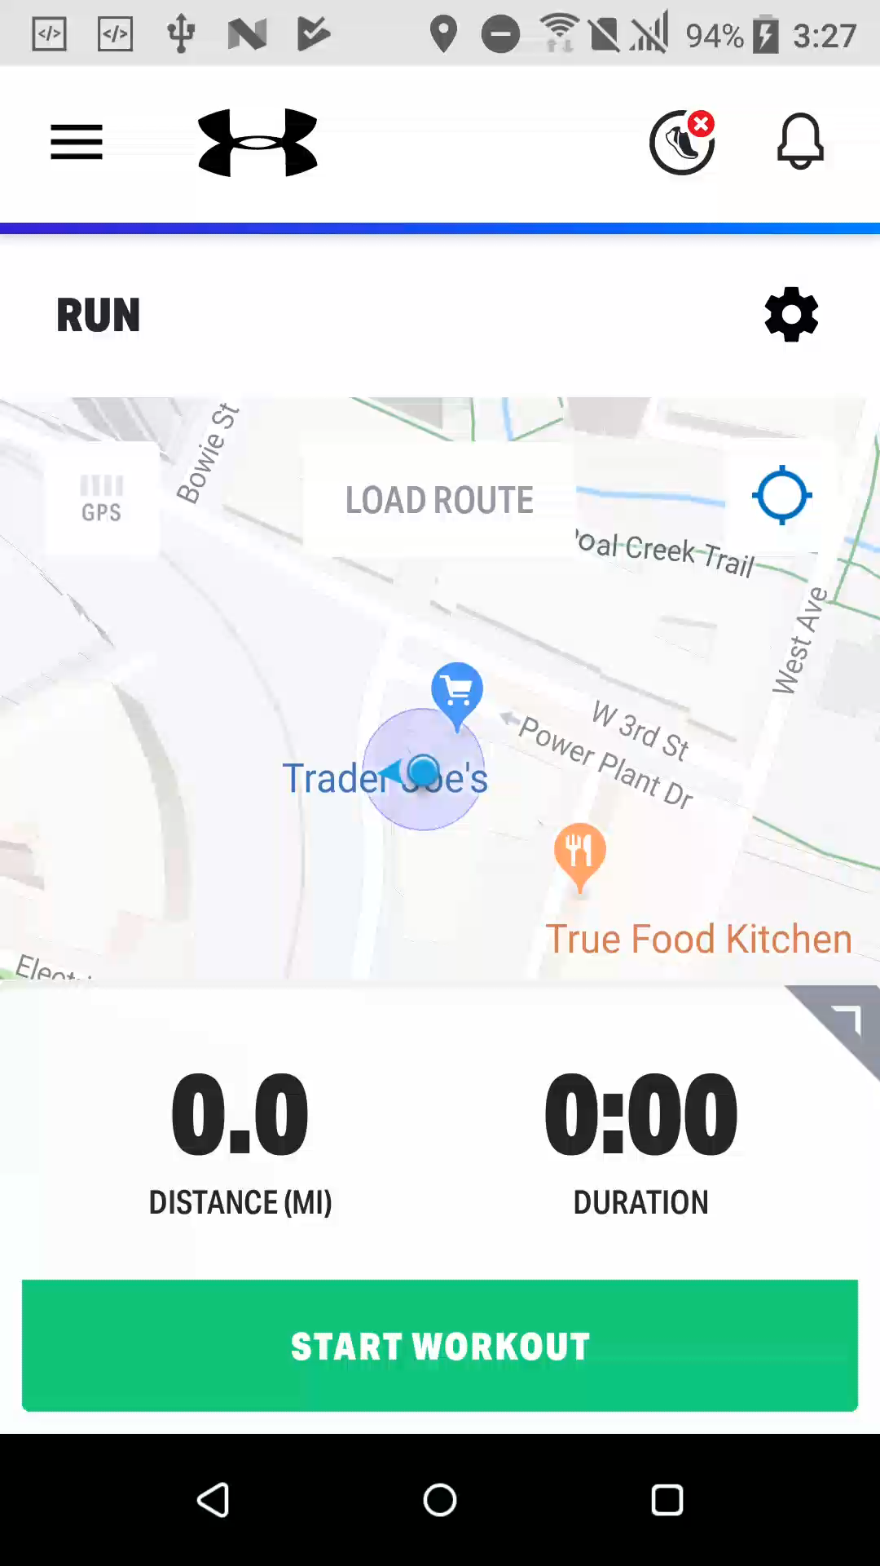
Demo
SLIDE TITLE
CONFIDENTIAL & BUSINESS PROPRIETARY INFORMATION OF UNDER ARMOUR, INC.

Slide 8
Thank you

